Slide 1
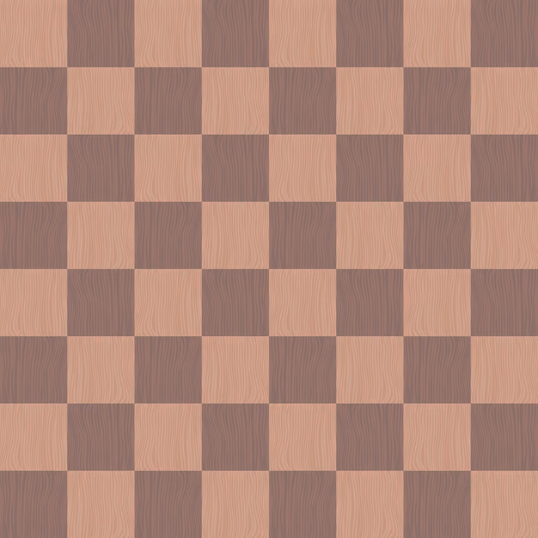
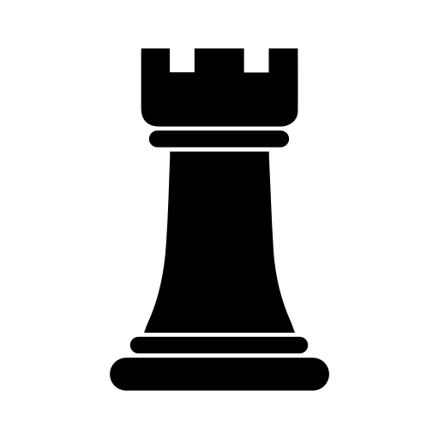
Video Chess Tracking
Dominic Lagona

Slide 2
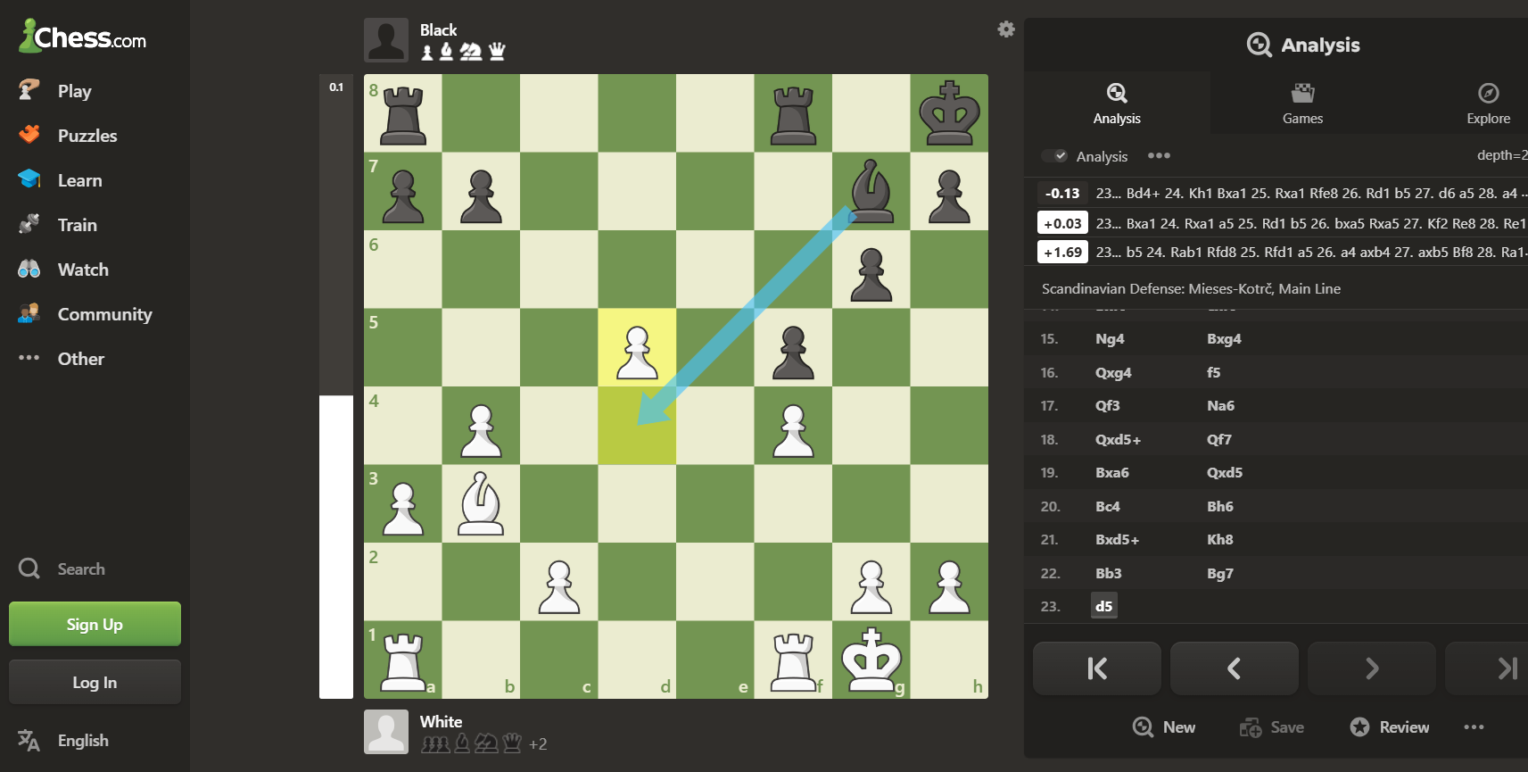

Slide 3
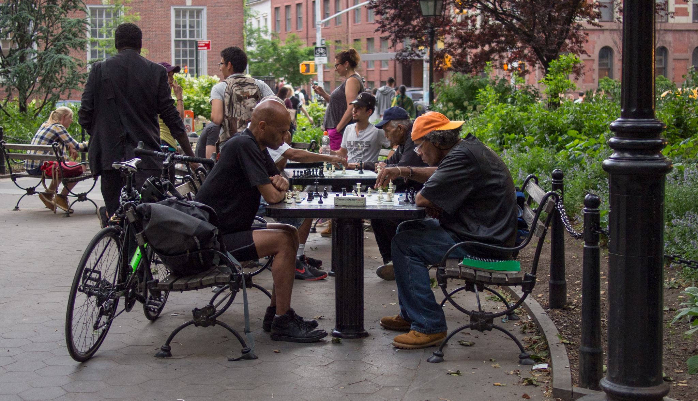

Slide 4
Project Subcategories
Week 2
Calibration
Move Tracking
Determining Good vs Bad Frames
Building An App

Slide 5
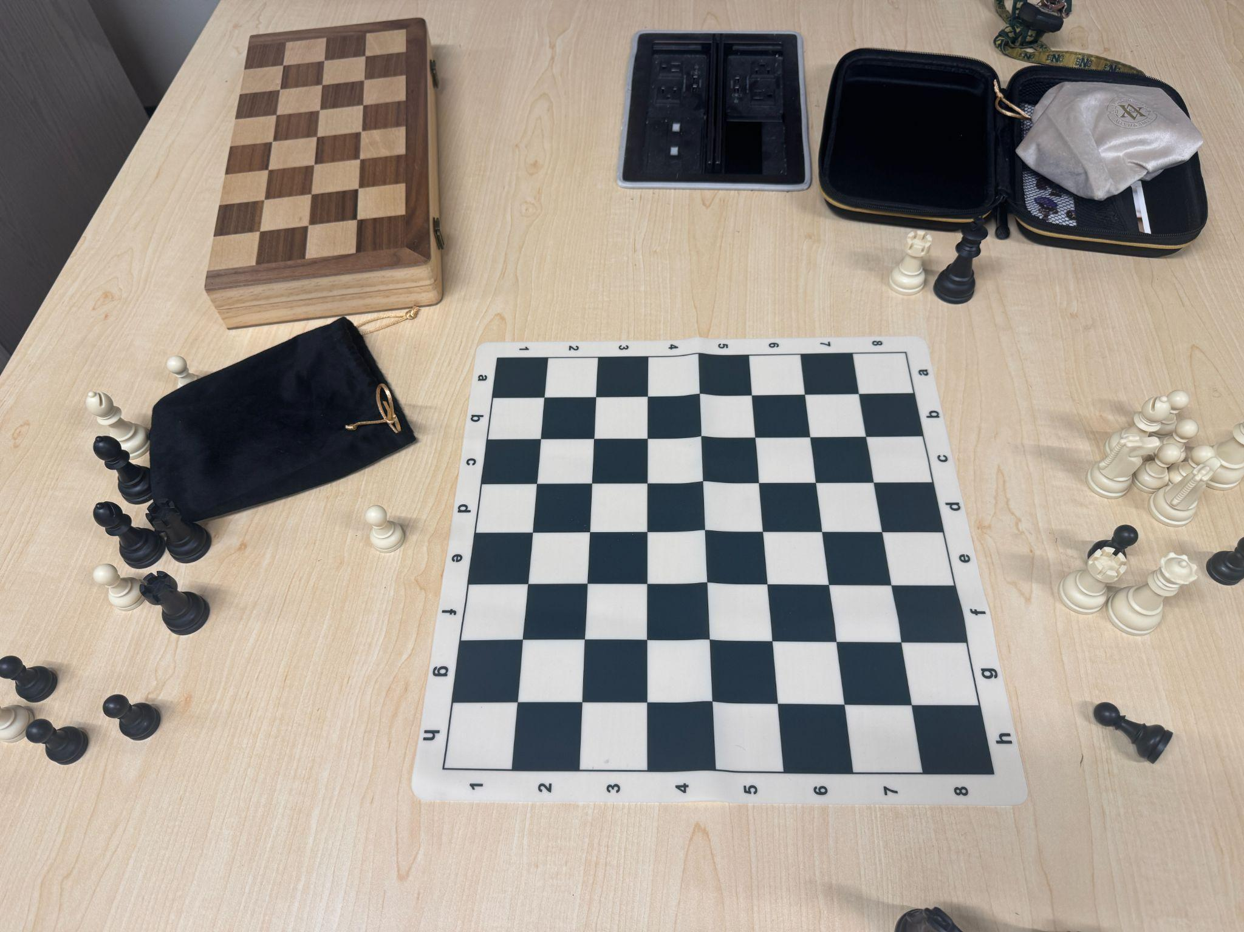
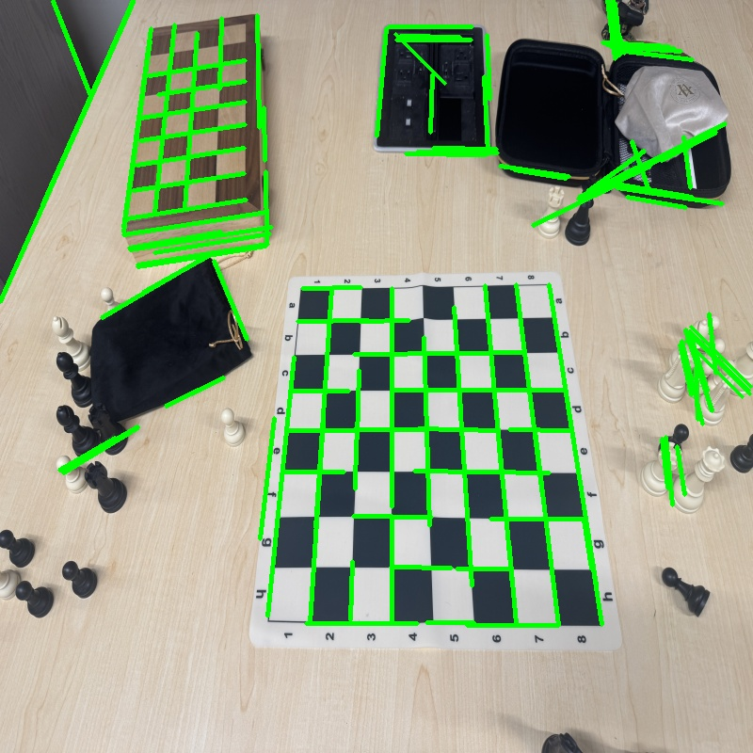
Calibration
Weeks 2-5

Slide 6
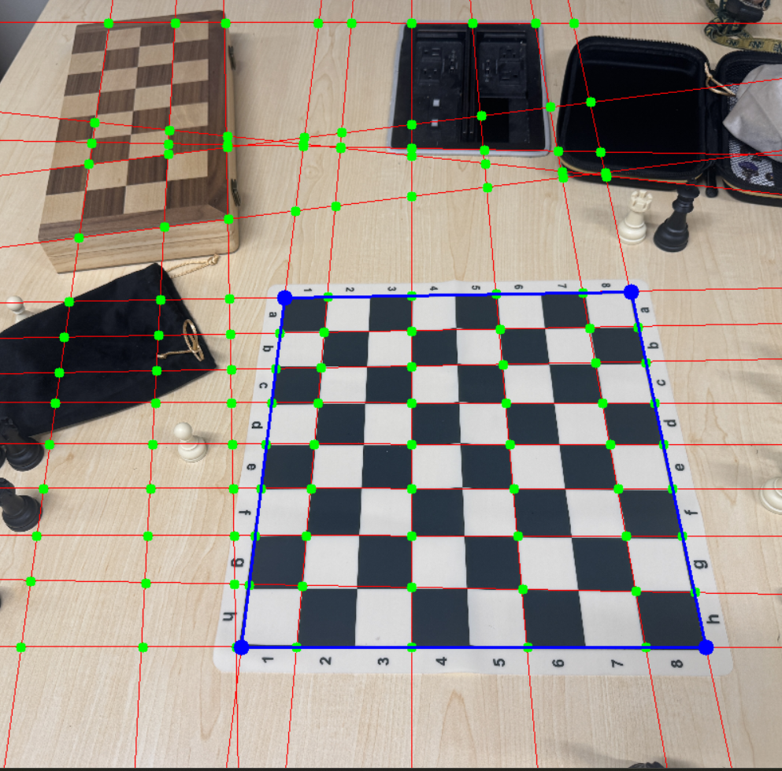
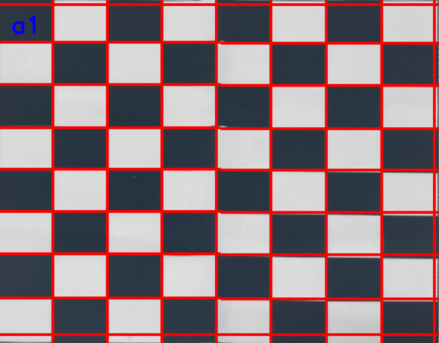
Calibration
Weeks 2-5

Slide 7
Project Subcategories
Calibration
Move Tracking
Determining Good vs Bad Frames
Building An App

Slide 8
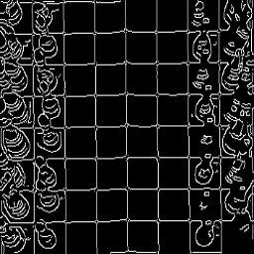
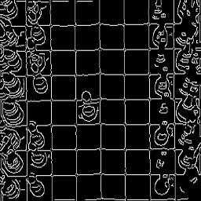
Move Tracking
Weeks 2-8

Slide 9
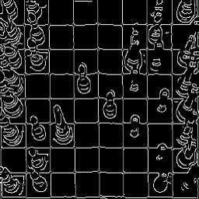
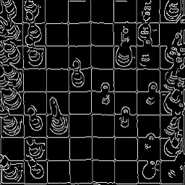
Piece Captures
Weeks 2-8

Slide 10
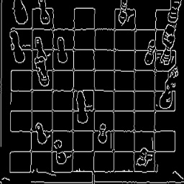
Piece Bleeding
Weeks 2-8

Slide 11
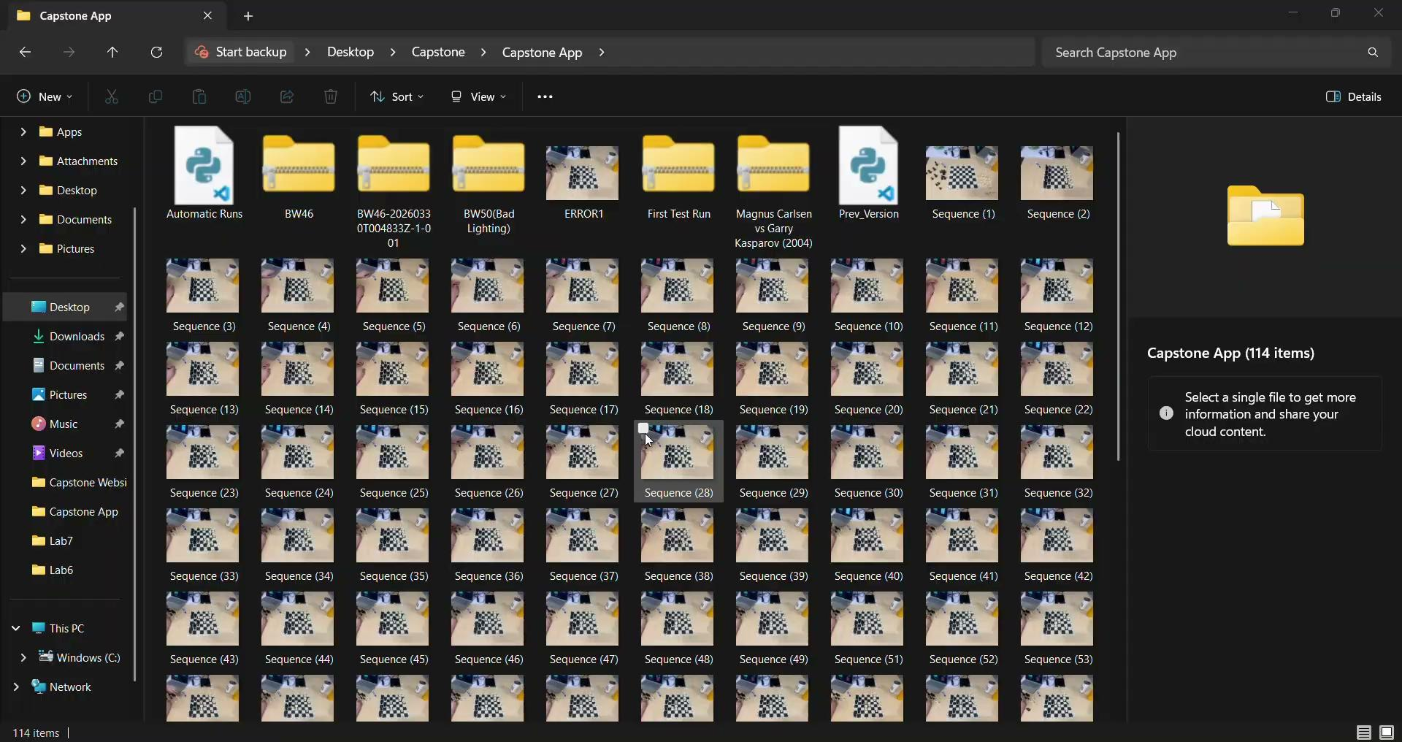
Full Runs
Weeks 2-8
Notes:
97% accuracy…. Buttttt we wanted 100%
Piece Hiding
Piece Overshooting

Slide 12
Project Subcategories
Week 9
Calibration
Move Tracking
Determining Good vs Bad Frames
Building An App

Slide 13
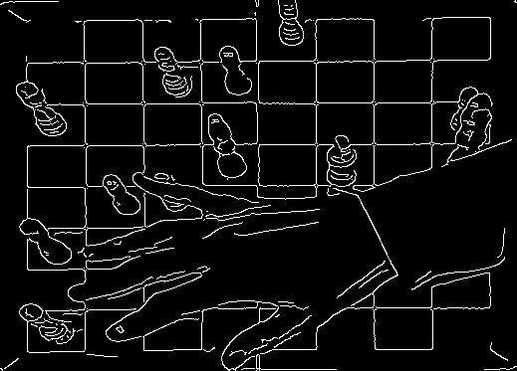
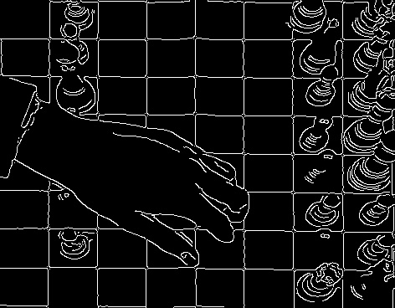
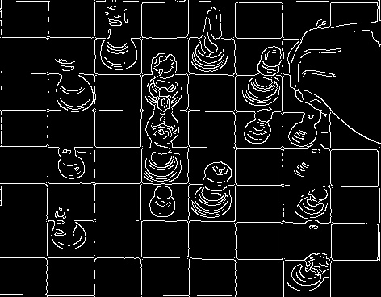
Why We Need To Determine Frames
Weeks 9-11
Notes:
Ending in failure :( ?! Or not

Slide 14
Good vs Bad Frames Using Pixel Detection
Weeks 9-11
Notes:
Ending in failure :( ?! Or not

Slide 15
Good vs Bad Frames Using Pixel Detection
Weeks 9-11
Notes:
Ending in failure :( ?! Or not

Slide 16
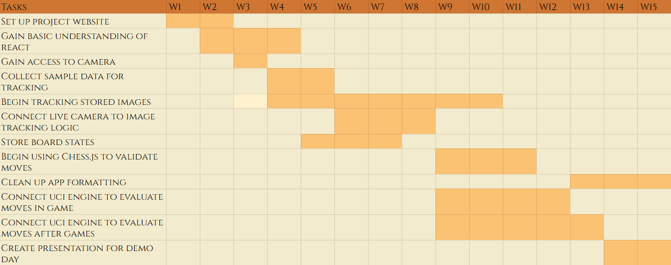
Panic Time?
Week 12
Notes:
Ending in failure :( ?! Or not

Slide 17
Initial Goals
Week 12
Robust App
As Little Human Interaction as Possible
Autonomous
Notes:
Ending in failure :( ?! Or not

Slide 18
Week 13
Convolutional Neural Net!

Slide 19
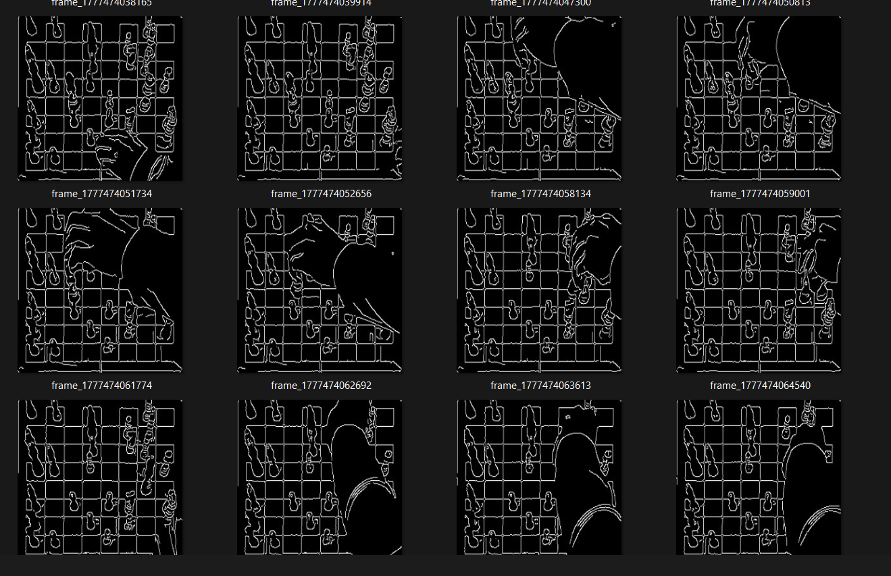
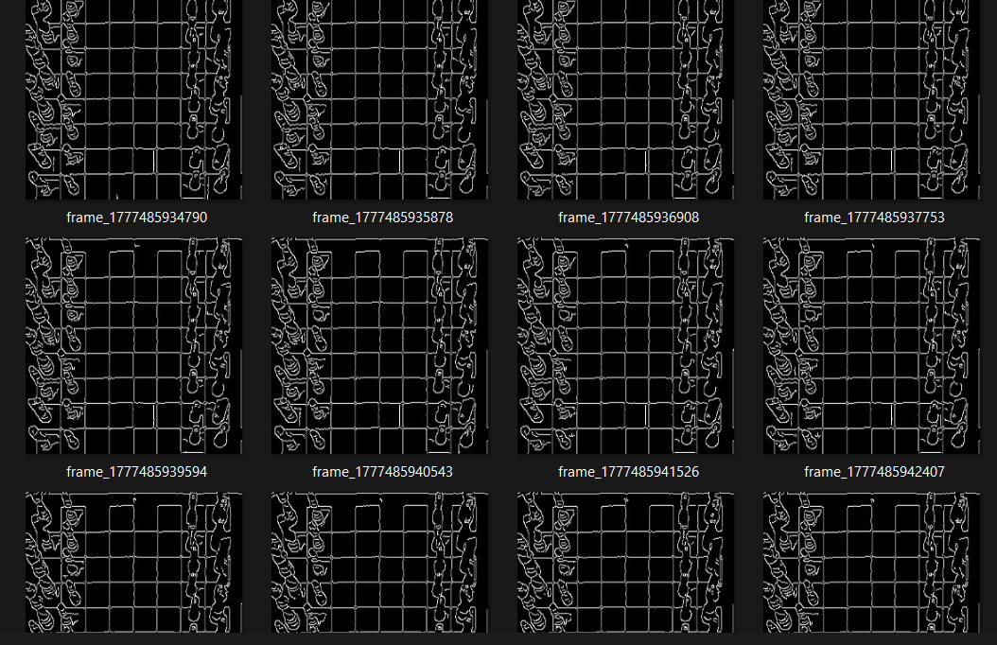
Data Collection
Week 13
Hands vs No Hands

Slide 20
Project Subcategories
Week 14
Calibration
Move Tracking
Determining Good vs Bad Frames
Building An App

Slide 21
How my Data Communicates
Week 14
Calibration Logic
Calibration Page
Current Game JSON
Server
Hand Detection Logic
Game
Page
Move tracking logic

Slide 22
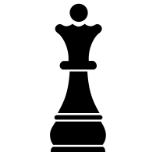
FINAL PRODUCT

Slide 23
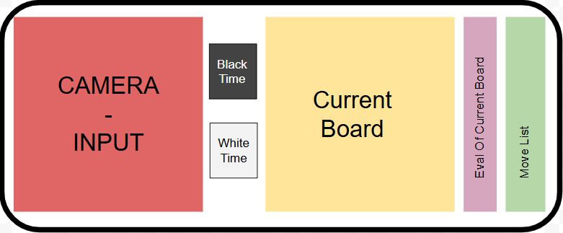
Initial UI Design
Week 2

Slide 24
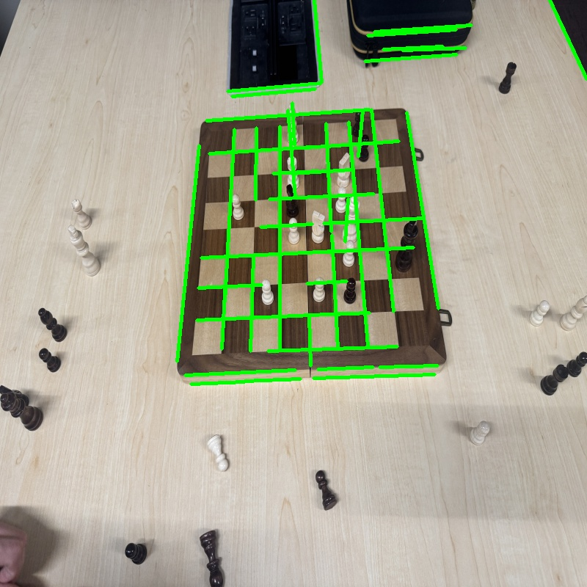
Hough Lines
Weeks 2-5

Slide 25
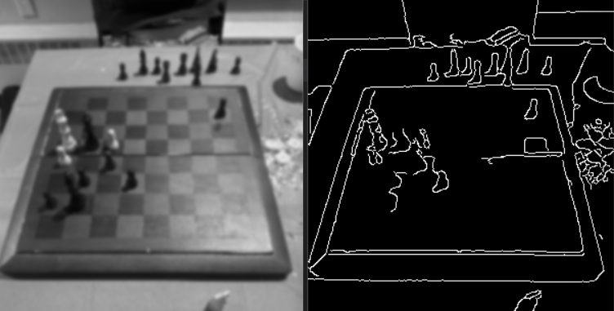
Edge Detection
Weeks 2-8

Slide 26
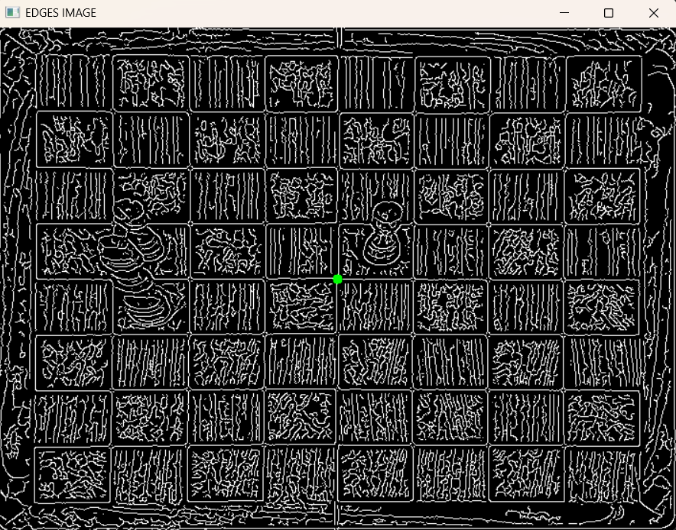

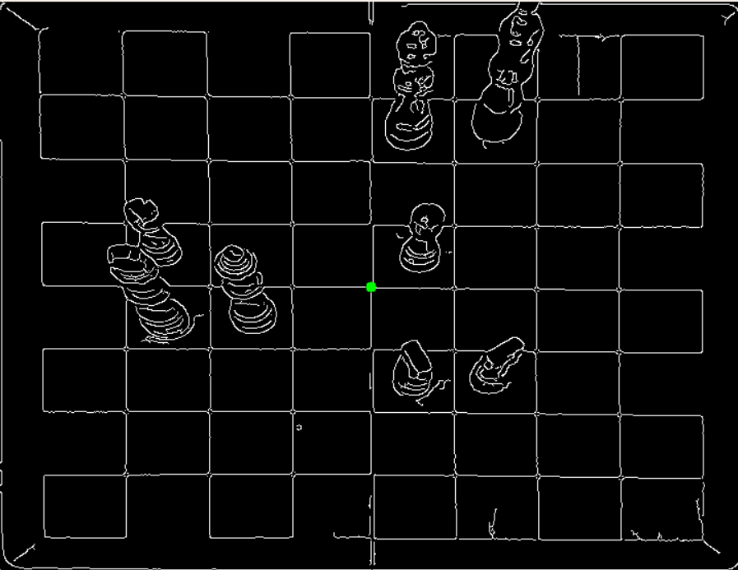
Aperture Size
Weeks 2-8
Aperture 9:
Aperture 3:

Slide 27
Project Deliverables
Calibrate the device
Locate moving objects in visual data.
Store the sequence of chess moves in a file without user input.
Allow for players to play timed games
Provide post-game analysis of which move(s) were significantly impactful to the outcome of the match.

Slide 28
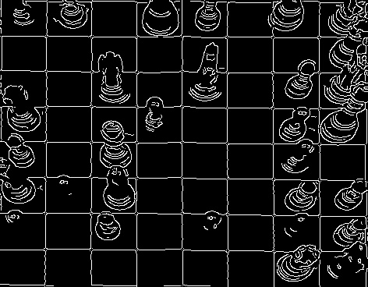
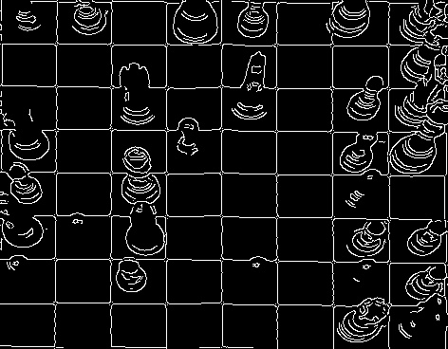
Thresholds
Weeks 2-8
(40, 80):
(60, 30):

Slide 29
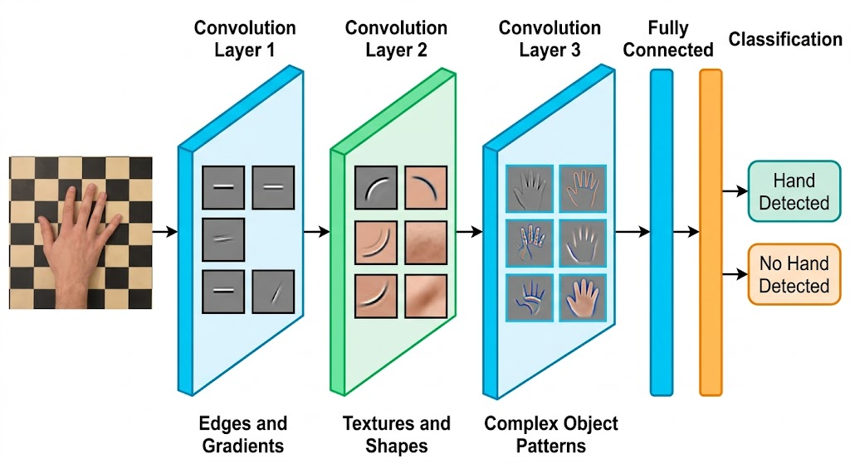

Slide 30
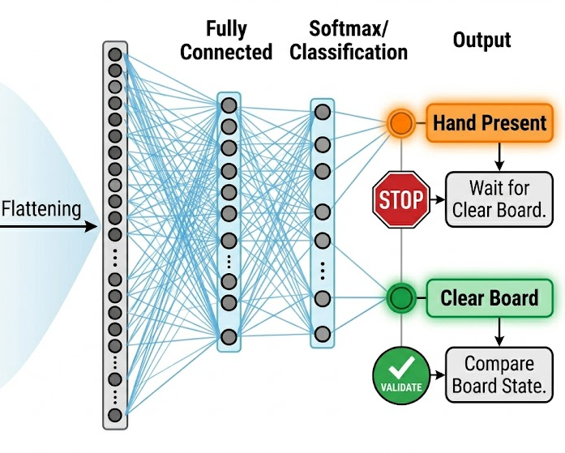

Slide 31
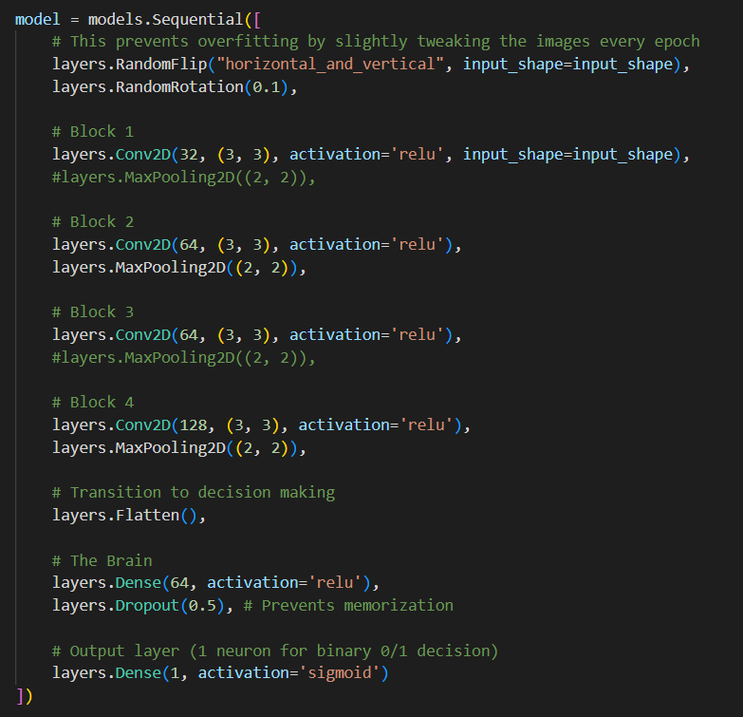
Training Model
Week 13

Slide 34
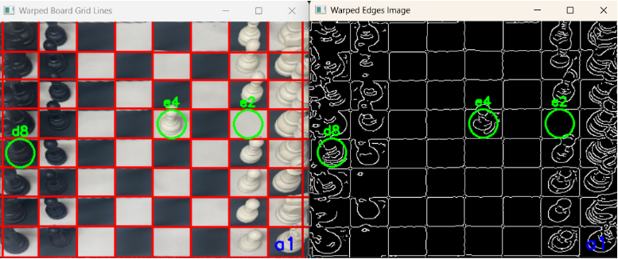
Move Tracking
Weeks 2-8
Camera

Slide 35
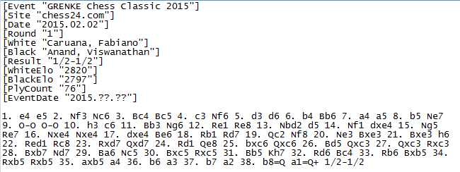
PGN
Weeks 2-8
Notes:
97% accuracy…. Buttttt we wanted 100%
Piece Hiding
Piece Overshooting

